Slide 1



EV Charging Stations: Permitting and Inspection
Sub-regional Workshop for Local Governments
June 2, 2016
SANDAG and Center for Sustainable Energy

Slide 2




SANDAG & Center for Sustainable Energy
  Independent nonprofit organization
  Our mission: Accelerating the transition to a sustainable world powered by clean energy
    Program management
    Training and education
    Technical assistance
San Diego Association of Governments
  Forum for regional decision-making
  Transportation planning and construction
  Sustainable development
Notes:
SANDAG-The 18 cities and county government are SANDAG, the San Diego Association of Governments. This public agency serves as the forum for regional decision-making. SANDAG builds consensus; makes strategic plans; obtains and allocates resources; plans, engineers, and builds public transportation, and provides information on a broad range of topics pertinent to the region's quality of life.
CSE is an independent nonprofit organization that accelerates the transition to a sustainable world powered by clean energy. We work in five states across the country, with headquarters in San Diego. We provide technical assistance and training services.
CSE Plug-In Electric Vehicle Initiatives: PEV Planning and ZEV Implementation
Implementation of the San Diego Regional Readiness Plan

Slide 3
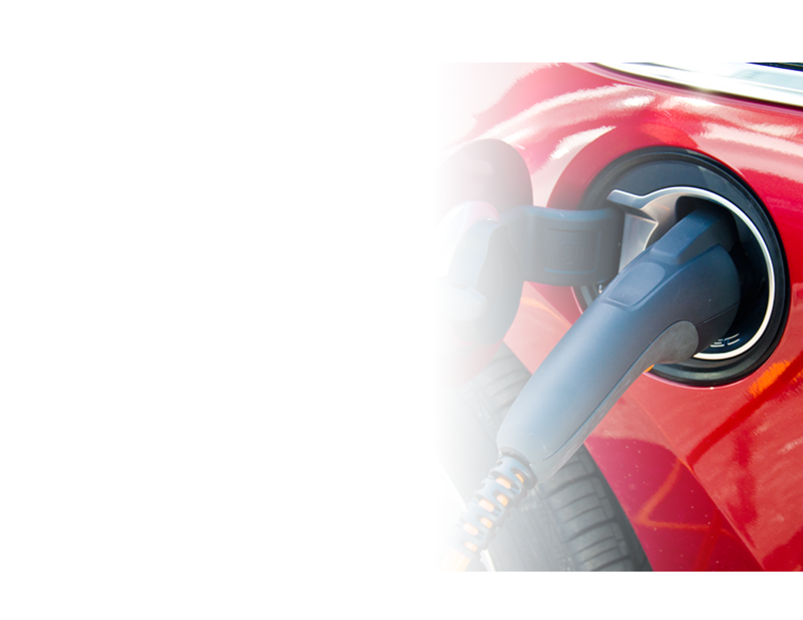
Plug-in San Diego
Program Goal:
Ensure the San Diego region is
ready for plug-in electric vehicles
Local Governments:
Resources to advance regional consistency in EV charging plan review, inspection and installation
Notes:
Through funding from the California Energy Commission, the San Diego Association of Governments (SANDAG) and the Center for Sustainable Energy (CSE) have partnered to implement the EVCS best practice recommendations from the 2014 San Diego Regional PEV Readiness Plan (Readiness Plan) through an implementation program known as Plug-In SD. Plug-in SD will help develop a regionally consistent, streamlined process for permitting and installation of residential and commercial electric vehicle charging stations (EVCS), assist with EVCS siting and increase awareness of PEVs and EVCS. A regional EV expert will be available to provide direct technical assistance to municipalities and other EVCS stakeholders through outreach and education.

Slide 4
Growth of the PEV Market in San Diego

Slide 5
Anticipated Growth in ZEVs
Notes:
California has a goal for 1.5 million zero-emission vehicles on the road by 2025. With 1.5 million zero-emission vehicles expected to hit California roads by 2025, there also will be a massive demand for new charging stations.
ZEV Action Plan: https://www.opr.ca.gov/docs/Governor's_Office_ZEV_Action_Plan_(02-13).pdf

Slide 6
AB 1236, Streamlined EV Permitting

Slide 7
What is AB1236?
Bill requires adoption of an ordinance to streamline and expedite the permitting process for EV charging stations
  September 30, 2016 requirement for larger cities (population>200,000)
  September 30, 2017 requirement for smaller cities (population<200,000)
Checklist for expedited permit review
Publish checklist and permit documents
on the web
Allow for electronic submittal
Notes:
AB 1236 was enacted in October 2015 requiring local governments to adopt ordinances to expedite and streamline the permitting process for installing electric vehicle charging stations.
“Electronic submittal” means the utilization of one or more of the following: email, internet, fax.
Full Bill text for AB 1236 can be found here: https://leginfo.legislature.ca.gov/faces/billTextClient.xhtml?bill_id=201520160AB1236

Slide 8
AB 1236 vs. AB 2188
AB 2188 (Muratsuchi), Solar Permitting | Like AB 2188, AB 1236 says | AB 1236 (Chiu and Low), EV Permitting
Assures a single inspection that must be performed in a timely manner Substantially conform to the current version of OPR’s California Solar Permitting Guidebook 45 days from the date of application receipt to be denied in writing, otherwise shall be deemed approved | Requires cities and counties to adopt an expedited permitting ordinance Permits electronic signatures on relevant permitting documents and electronic submittals Adopt a checklist of requirements to be eligible for expedited review Allows modification of checklists and standards found in the Guidebooks due to unique conditions | Permit application must demonstrate compliance with the utility’s policies prior to approval Refer to guidelines contained in OPR’s ZEV Guidebook and the PEV Infrastructure Permitting Checklist
Notes:
The State has been active in making it easier to install EV infrastructure similar to efforts in solar (AB 2188) and the state continues to support efforts. AB 2188 requires all jurisdictions in California to adopt an ordinance that creates a streamlined, expedited permitting process for small residential rooftop solar energy systems. AB1236 used AB 2188 as a framework for expediting the permitting process.
OPR ZEV Guidebook: https://www.opr.ca.gov/docs/ZEV_Guidebook.pdf (pg. 111-115 for the Infrastructure Permitting Checklist)

Slide 9
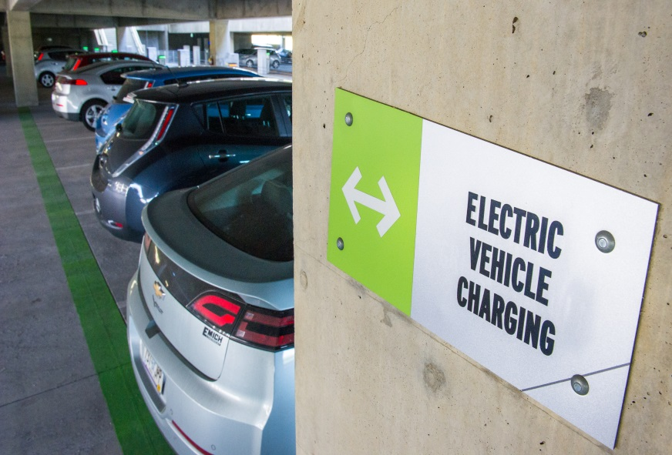
AB 1236 & Plug-in SD
Plug-in SD can help with AB1236 compliance
  Best Practices Report
  Permit and inspection correction sheets
  Installation checklists
  Standardized language for websites
  EV Expert assistance
Notes:
Permitting requirements vary from city to county and documentation is specific to each jurisdiction. To help jurisdictions comply with AB1236, PISD has developed resources and has sought input from the SD region to refine resources. PISD is communicating with OPR to inform their development of resources which will look similar to the resources that we are developing.

Slide 10
Best Practices Report
Common barriers to EVCS installations
Existing permit processes
Best practices:
  Clear, consistent website language
  EVCS permit guide/checklist
  Plan review/inspection correction lists
  Online services
  Fillable application
  Permit fee incentives
Notes:
The best practices reports serve as a resource to promote regionally consistent and streamlined EVCS permitting, inspection and installation processes for local governments and installers of EVCS. A few barriers to EVCS installations include lack of streamlined permitting and inspection processes and inconsistent costs across jurisdictions, varying and unpredictable installation costs, and lack of standard regional ordinances that facilitate the installation and access to publicly available charging infrastructure. The resources will act to reduce the barriers to EVCS installations.
Some existing processes include EVCS installation standards such as the CEC and workmanship requirements, equipment, determining proper electrical load, physical installation, post-installation equipment use and maintenance, and communications. All 19 jurisdictions require that an EVCS project be permitting by the Building Department before installation.
Full versions of the draft reports, Permitting and Inspection Best Practice Report: http://www.sandag.org/uploads/projectid/projectid_511_19814.pdf and Installation Best Practice Report: http://www.sandag.org/uploads/projectid/projectid_511_19815.pdf

Slide 11
Regional Best Practices

Slide 12
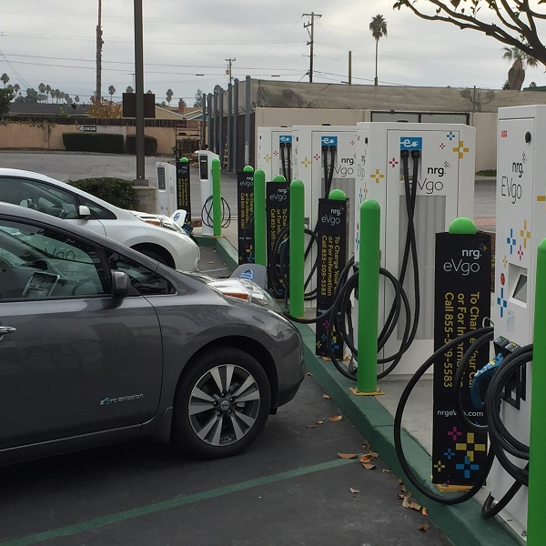
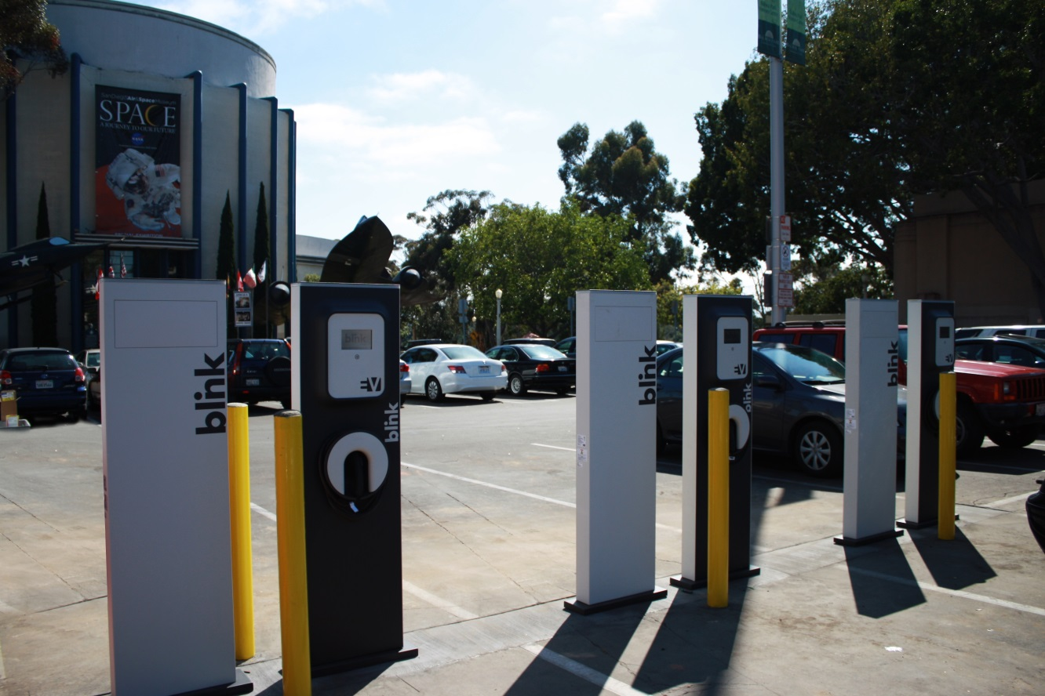
Regional Efforts
What is your jurisdiction doing?
What plans does your jurisdiction have?

Slide 13
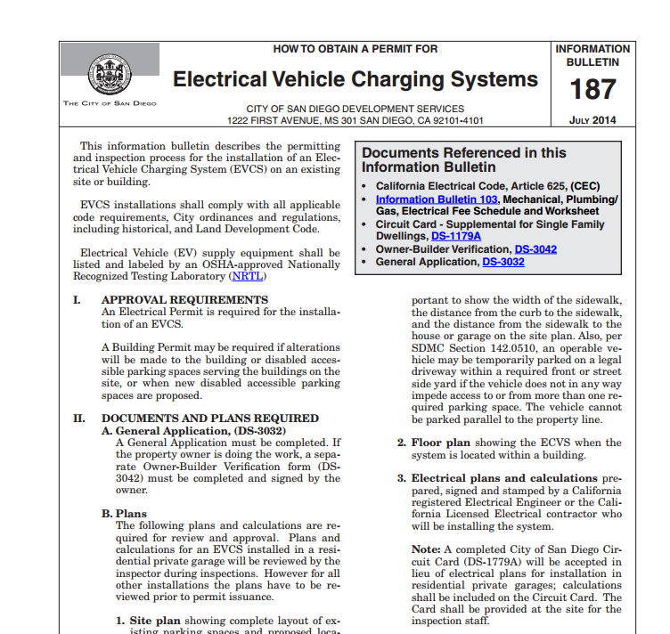
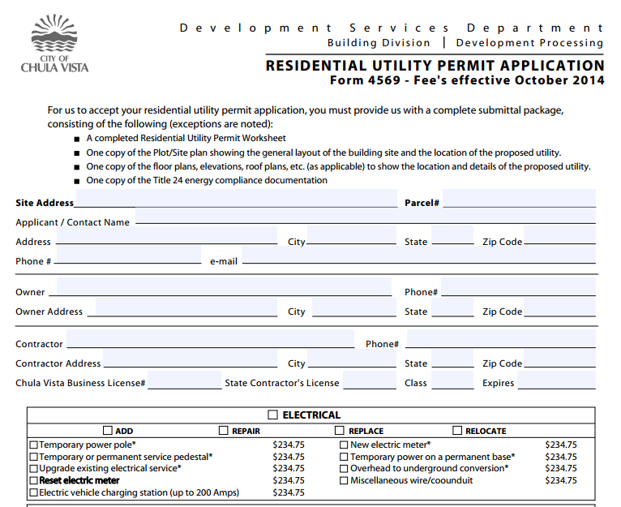
What the Region is Doing
Information Bulletins for Permits for Electrical Vehicle Charging Systems
Electric Vehicle Charging Station Permit Application
Notes:
Visit the websites of each jurisdiction shown to view existing resources. Several jurisdictions have published materials on their websites for
Chula Vista has permit applications for residential and non-residential EVCS and is developing additional resources such as a permit guide which created a distinct category for EVCS. Link to this application is here http://www.chulavistaca.gov/home/showdocument?id=954
City of SD will be updating their Info Bulletin 187 (https://www.sandiego.gov/sites/default/files/legacy/development-services/pdf/industry/infobulletin/ib187.pdf) as it relates to the requirements of AB 1236 and Technical Policy as it relates to accessibility requirements.

Slide 14
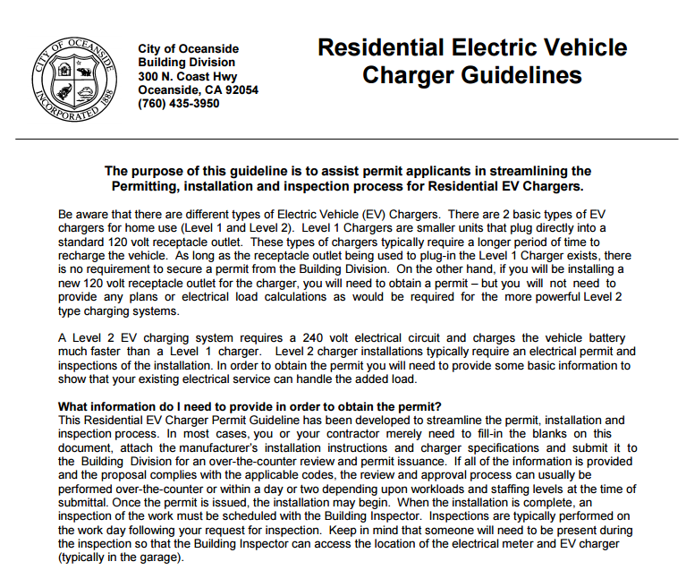
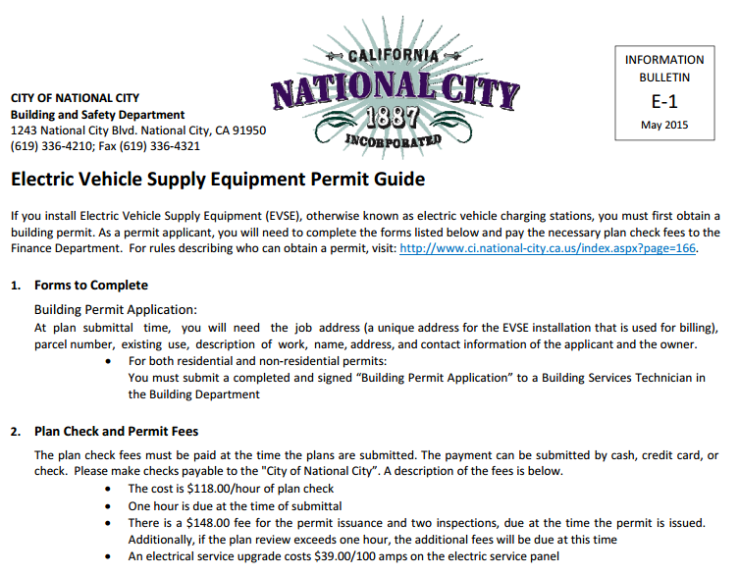
What the Region is Doing
Permit Guide for Electric Vehicle Supply Equipment (EVSE)
Electric Vehicle Charger Guidelines
Notes:
The resources highlighted summarizes information on electric vehicle chargers and EVSE in one document. This provides clarity for current and potential applicants and staff.
The City of National City has website information in a permit guide (https://www.google.com/url?sa=t&rct=j&q=&esrc=s&source=web&cd=1&cad=rja&uact=8&ved=0ahUKEwiejfOYmt_MAhVU32MKHed9CfQQFggcMAA&url=http%3A%2F%2Fnationalcityca.gov%2Fmodules%2FShowDocument.aspx%3Fdocumentid%3D11402&usg=AFQjCNHCMgN6UVefsiT_82QY7wuEdPtx_w&sig2=6GIiCmI21_vkHgEnhfMzgg&bvm=bv.122129774,d.cGc) which includes a review timeframe and links to beneficial PEV resources for applicants to reference.
The City of Oceanside has guidelines (http://www.ci.oceanside.ca.us/civicax/filebank/blobdload.aspx?blobid=30053) which include the type and size of wire and conduit for various circuits for EVCS as well as conduit supports required.
The City of Encinitas has permit fee incentives with a program that waives permitting fees for basic installations of home EVCS and reduces permitting fees by an equivalent amount for larger and more complex installations. Encinitas also has a Green Building Incentive Program (http://www.encinitasca.gov/index.aspx?page=325)
Several jurisdictions provide online permitting services such as the City of San Diego (for residential) installations, County of San Diego, and Chula Vista (Accela Citizen Access)

Slide 15
Resources for the San Diego Region

Slide 16
Plug-in SD Resource Integration
Intent to Install EVCS
Permit Application
Operational
EVCS
Website
Inspection
Installation Checklists
Notes:
PISD resources created to be used together (integrated) in order to produce predictable EV charging installation outcomes. Website is the entry to the funnel which pulls host sites, electrical contractors (and others in) while they are in the intention stage. The information available on the website, starting with the Installation Checklist, should narrow their actions creating more predictable permit application submittals. The Permit Application Correction Sheets will create a standardized/consistent response that reinforces the Installation Checklist content. Installation following the Installation Checklist guidance will align well with the issued permit and reduce the need for corrections at Inspection. The Inspection Correction Sheets will create a standardized/consistent response that reinforces the Installation Checklist content. The consistency throughout (and if implemented region-wide) will lead to more efficient and predictable EV charging installations.

Slide 17
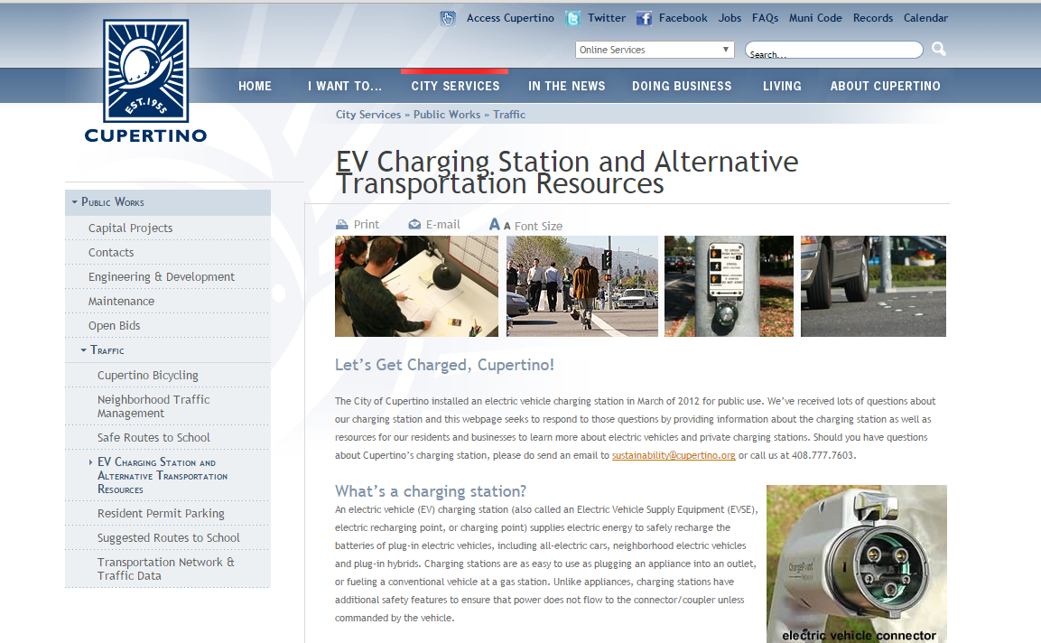
Plug-in SD Resources for EV Charging
Website Language
  Specific direction for the general public
  Guide covers requirements and approach for permitting
Notes:
The City of Cupertino’s website has a page that provides information on charging stations in the City of Cupertino including basics of a charging station, local resources to learn more, and charging station planning resources that includes the permit requirements, code and accessibility requirements, and fee schedule detailing the specific cost ranges for an electric vehicle charging station. This page can be found here http://www.cupertino.org/index.aspx?page=1198.
Plug-in SD has a website language guide as a resource to prepare for the influx of EV charging station permit applications. Building department staff can save valuable staff time and resources by providing clear written instructions on the EVCS permitting process on their websites. Providing clear information on jurisdiction websites also reduces time spent by staff answering simple applicant questions. Simple web design concepts including the use of images, bulleted lists, and ensuring information is not buried behind too many clicks or presented as a wall of text can assist building departments in presenting information more succinctly and clearly, which in turn, enables applicants to navigate the local permitting process in a quicker, more straightforward way.

Slide 18
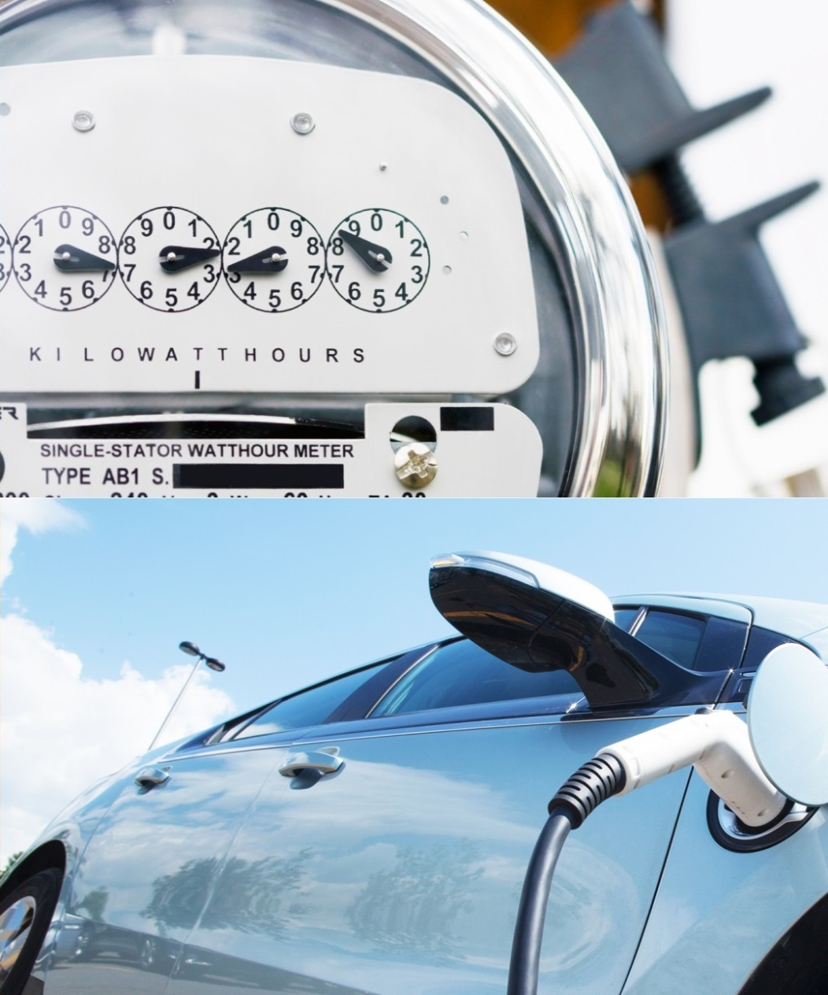
Correction Sheets & Checklists
Intended to cover common situations (80% of installations across SF, MF, and commercial property types)
Notes:
Installation Checklists provide electrical contractors and building owners with an overview of the entire process when installing EVCS from permitting to installation and inspection. The resources overall provide regional consistency and efficiency which can minimize staff time and time needed for applicants to make plan corrections.
Common installations consist of installs that use the existing panel, simple connections and existing parking. These do not cover service relocation, parking reconfiguration, and more complex electrical requirements

Slide 19
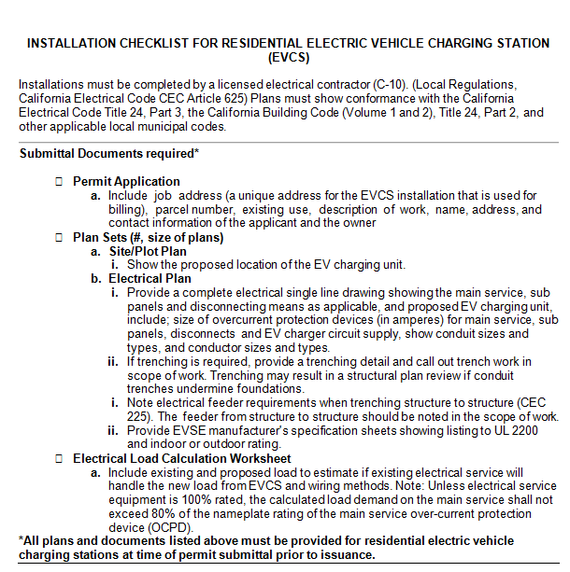
Plug-in SD Resources for EV Charging
Installation Checklists
  Broken down by type: Residential, Non-Residential, MUD
  General and electrical contractors permitting and installing EVCS
  More consistent applications, plans and installations
Notes:
The checklists are broken down by type (residential, non-residential, and MUD) because there are different considerations for each property type. Non-residential includes commercial retail, workplace, and industrial sites.

Slide 20
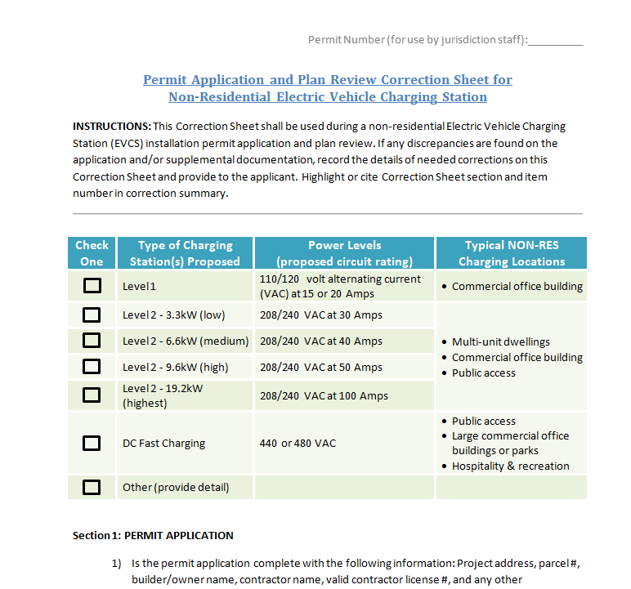
Plug-in SD Resources for EV Charging
Permitting and Inspection Correction Sheets
  Broken down by type: Residential, Non-Residential, MUD
  AHJ staff performing plan review and inspection
  Consistent expedited execution

Slide 21
Key Considerations for EVCS
Electrical System Evaluation
  Power supply requirements
  Equipment Upgrades (Transformer, Wiring, Panel)
Physical Requirements
  Proximity of electrical power supply to desired charging location (service room, transformer, etc.)
  Physical protection of equipment (wheel stops, bollards, clear floor space, etc.)
  Signage, stencil, and striping
  Layout within parking areas

Slide 22
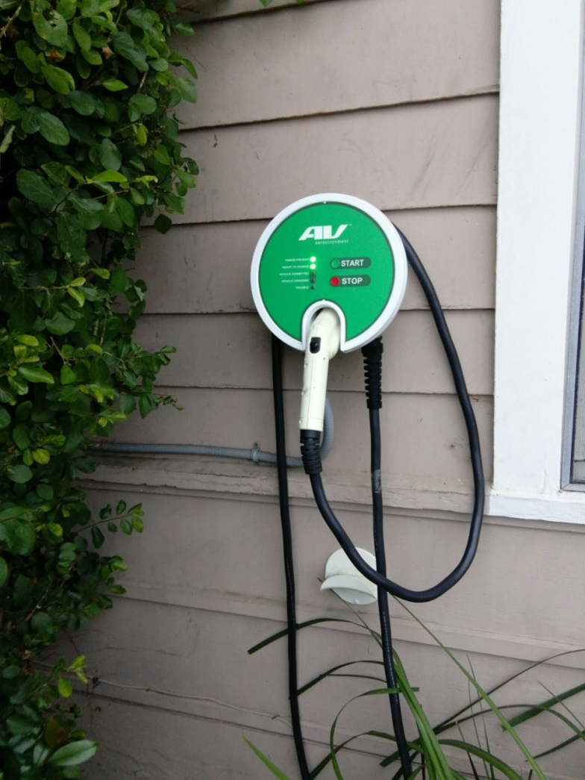
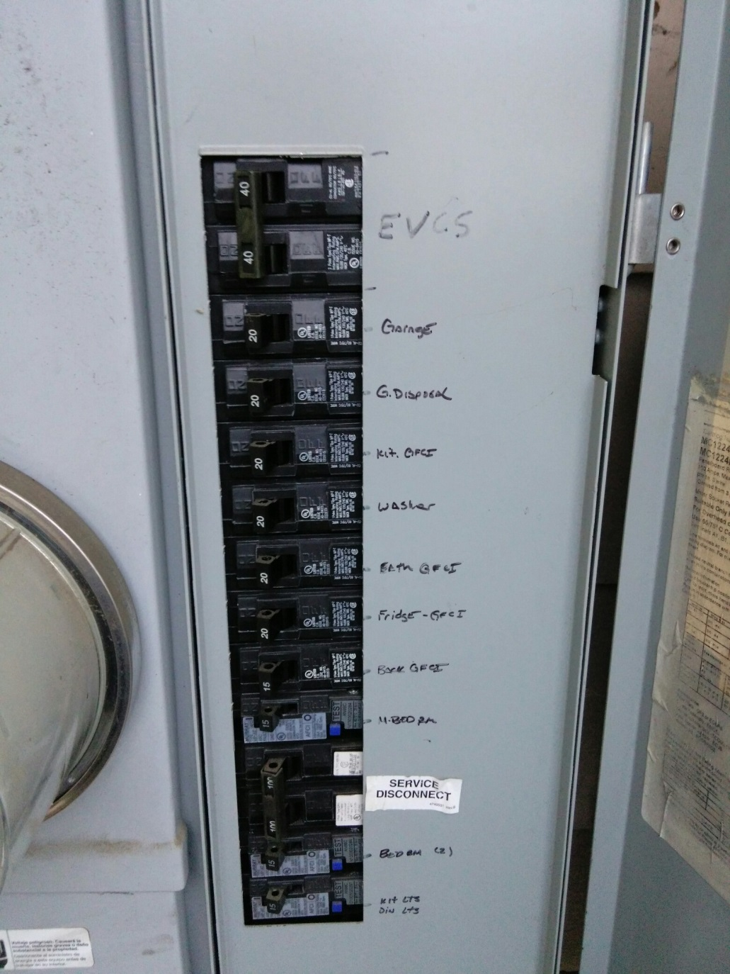
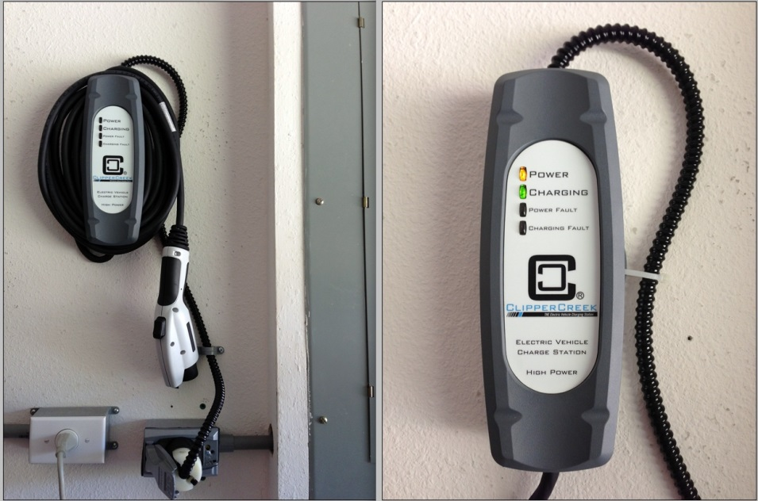
Residential Installation
Notes:
For indoor installation in the garage, reference Section 2, number 2 for ventilation requirements. (Note, most modern electric vehicles do not require ventilation)
For all residential installations:
Reference Residential Inspection Sheet, Section 3, number 4a for vertical clearance requirements.
Reference Residential Inspection Sheet, Section 3, number 2 for electrical equipment clearances.
Reference Residential Inspection Sheet, Section 3, number 6 for EVCS markings.
Reference Residential Inspection Sheet, Section 3, number 8 for securely fastened listed wiring and fittings.
Reference Residential Inspection Sheet, Section 3, numbers 9 & 10 for overcurrent protection been installed.
Reference Residential Inspection Sheet, Section 3, number 12 for labeling and identification.

Slide 23
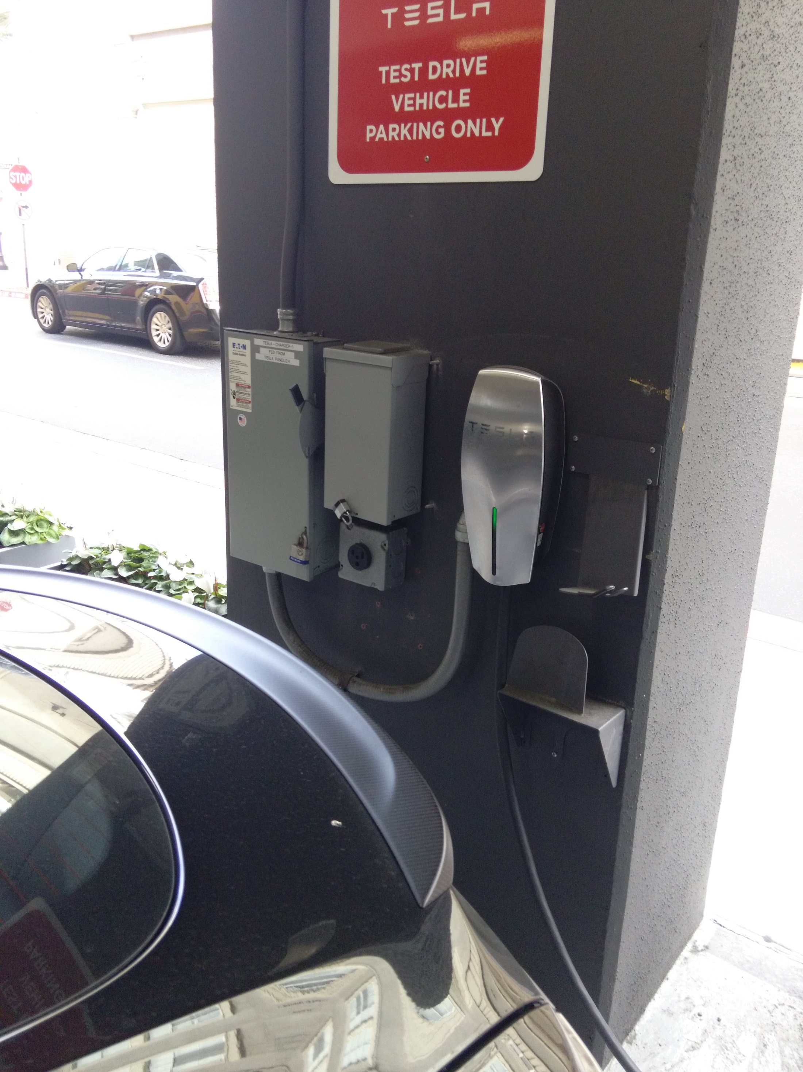
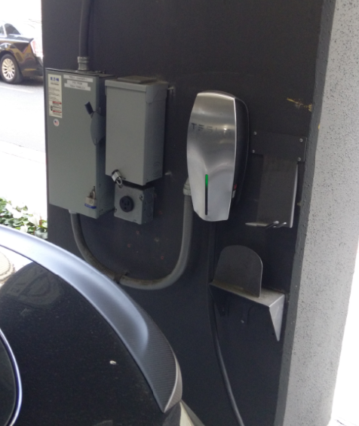
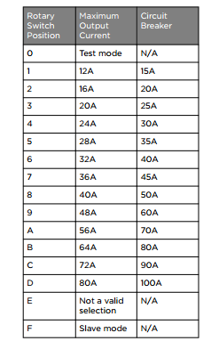
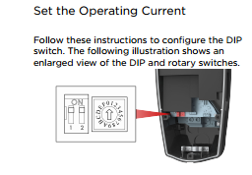
Operating Current
Notes:
Reference all Inspection Correction Sheets, Section 3, numbers 9 & 10 for overcurrent protection installation.
A 40 amp circuit, 32amp continuous output is the standard for Level 2 EV charging.
If the unit features adjustable power levels, verify the unit’s setting. Confirm that OCPD and conductor are appropriately sized to match continuous load. (For example, a 40 amp circuit for 32 amp continuous load)
Reference all Inspection Sheets Section 3, number 10a for adjusting the operating current.
Information from Tesla’s Manufacturer Installation Manual: https://www.teslamotors.com/sites/default/files/blog_attachments/80A_Wall_Connector_Installation_Manual_EN_JP_ES.pdf

Slide 24
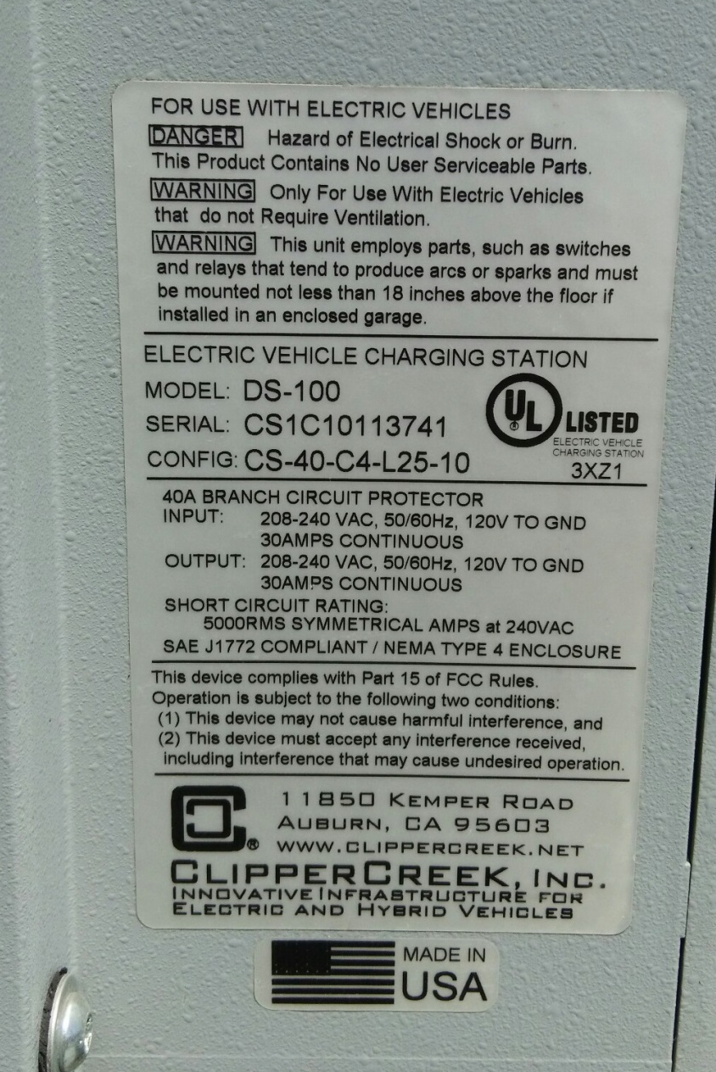
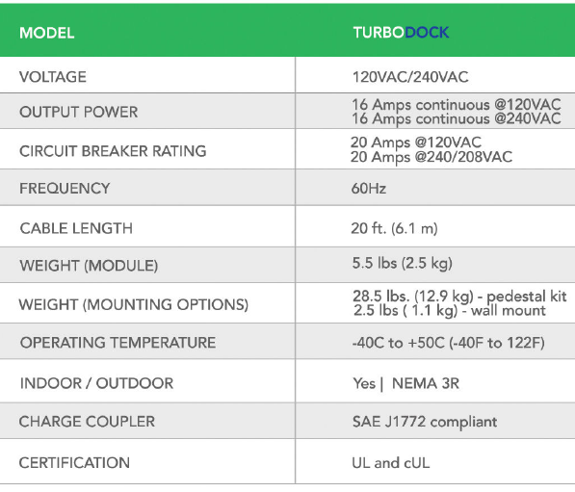
Residential Installation
Notes:
For an indoor installation in the garage, reference Section 2 of all Inspection Correction sheets for ventilation requirements. (Note, most modern electric vehicles do not require ventilation).
For all residential installations:
Reference Residential Inspection Sheet, Section 3, number 6 for EVCS markings.
Reference Residential Inspection Sheet, Section 3, numbers 9 & 10 for overcurrent protection been installed.
Reference Residential Inspection Sheet, Section 3, number 12 for labeling and identification.

Slide 25
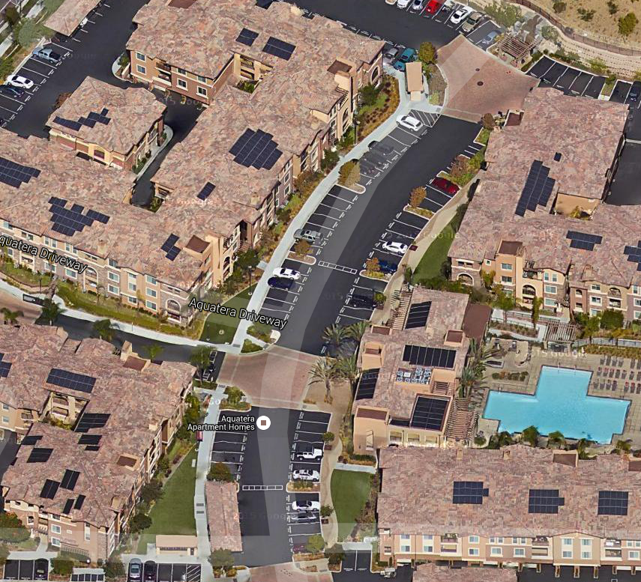
EV Charging at Multi-Unit Dwellings
Aquaterra Apartments
Transformer
  EV Chargers are noted in the green boxes
  EV Charger in the yellow box is for future charging; pedestal in place but no charger
Notes:
The layout of the MUD has surface parking with the greatest distances between where cars are parked and where service panels are located.
Extensive trenching was completed for an installation of this type from the distance from the transformer to the meter to the charging stations.
MUDs with multi-level parking decks may be able to electrify parking spaces with lower-cost surface conduit.

Slide 26
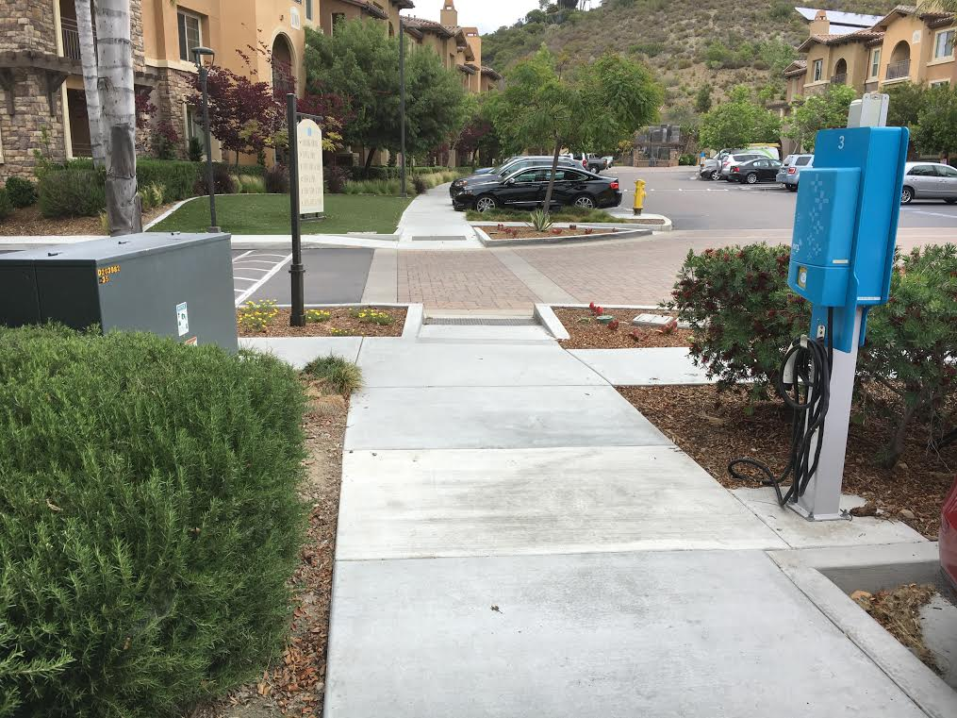
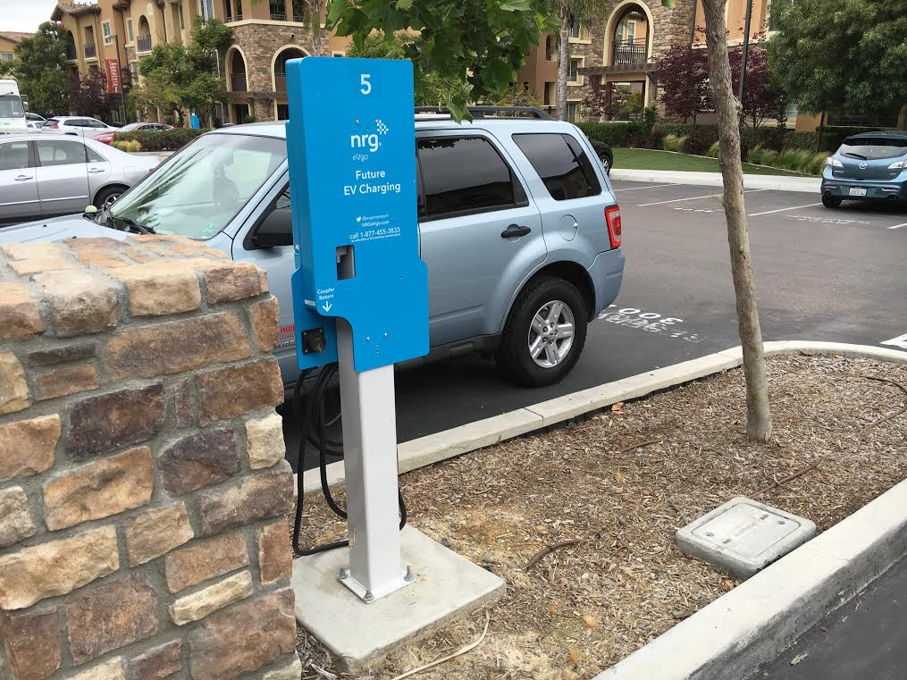
EV Charging at Multi-Unit Dwellings
Existing charging cord
For future EV charging
Notes:
Trenching is covered in all Permit Application and Plan Review Correction Sheets Section 4, number 5 and Residential Inspection Correction Sheet Section 3, number 14 and MUD and Non-residential Inspection Correction Sheet Section 3, number 15. Trenching may require rough and final inspection.
The permit may include conduit or wiring and breaker for future infrastructure, but not the actual unit per CalGreen requirements

Slide 27
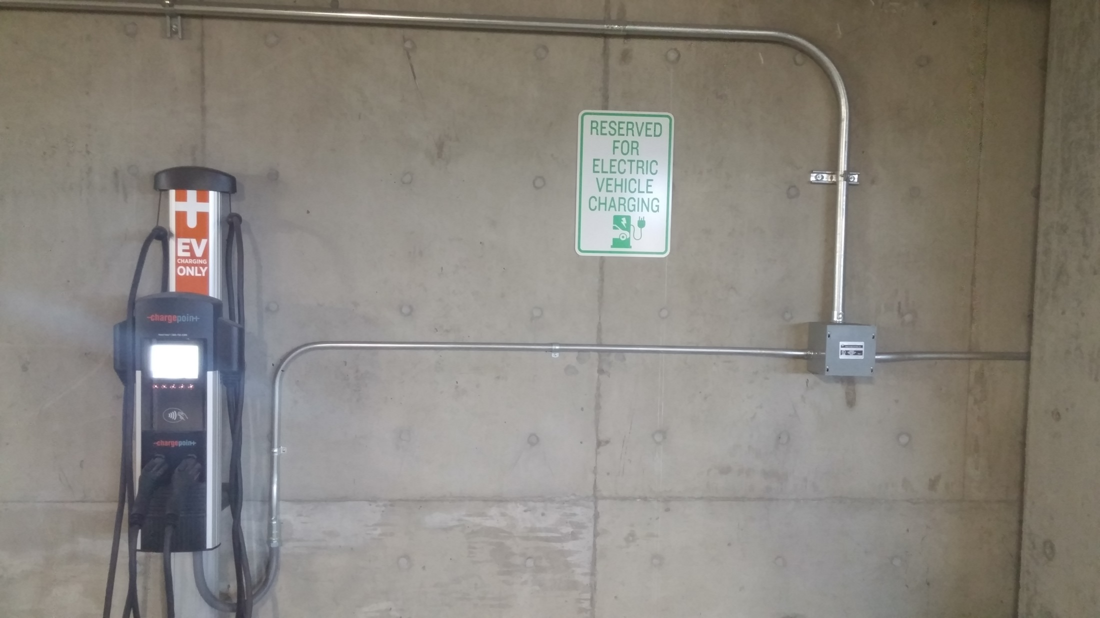

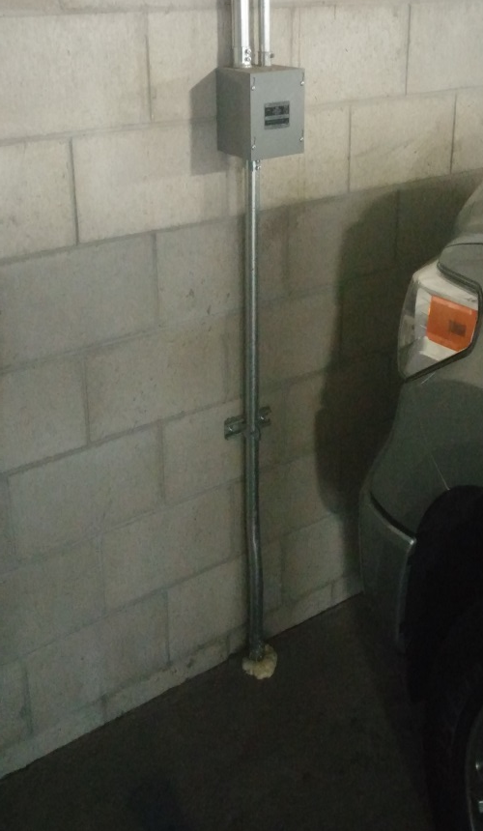
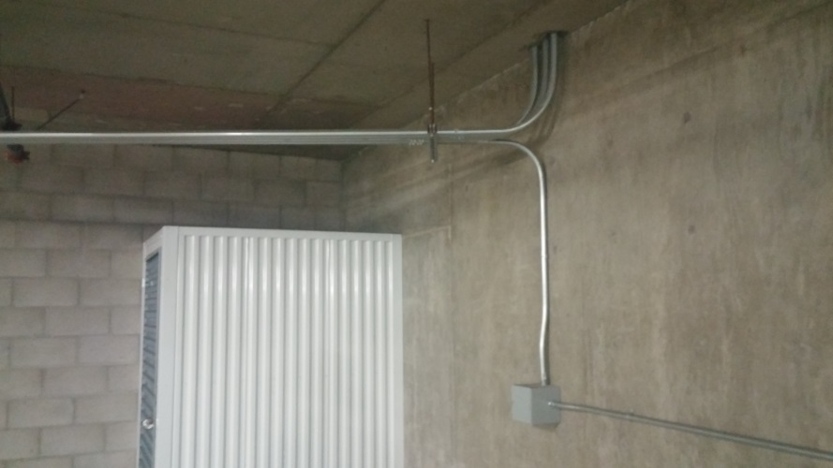
EV Charging at Multi-Unit Dwellings
Broadstone Corsair Multi-Unit Apartments
Notes:
Conduit should be appropriately sized and fixed at regular intervals. (Reference Non-Residential Inspection Sheet Section 3, number 9)
Surface conduit is very common in parking structures.
Reference MUD & Non-Residential Inspection Sheet Section 3, number 11 for securely fastening wiring and fittings.

Slide 28
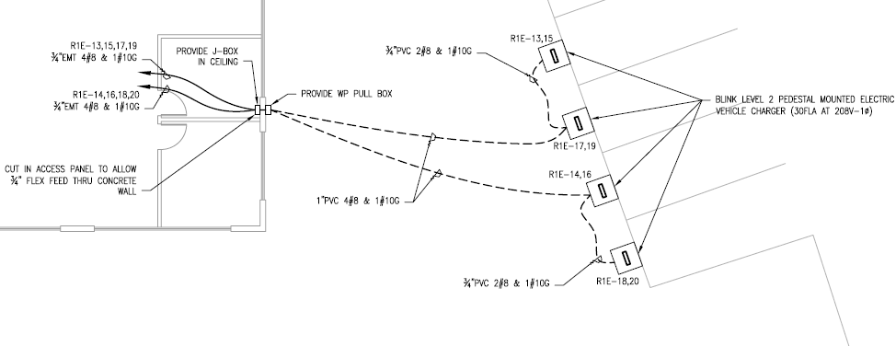
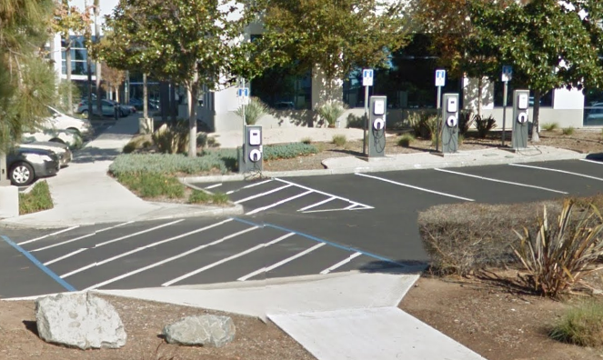
Site Plan- Workplace Installation
ADA striping of accessible EVCS space connects to existing path of travel
Notes:
Site plans and single line drawings are identified in the checklists, as well as in Section 3, number 1 of the MUD & Non-Residential Permitting Correction Sheet.
A site plan example for an office building is shown as a type of non-residential installation.
The checklist helps the landlord and electrical contractor consider how the install can take place and what the local jurisdictions require in the installation. The checklist can influence overall project design the design. This will make it easier to review when projects coming through meet expectation sand reduces corrections or having to send back projects.

Slide 29
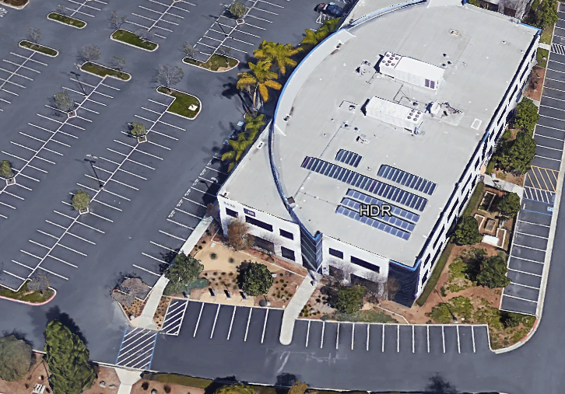
Workplace Installation
4 EV Chargers powered through T-bar drop ceiling in offices; through landscape
Approximate electrical room
Notes:
Accessible route requirements to EVCS service equipment and areas served by EVCS. The accessibility standards include path of travel requirements for new and existing buildings and facilities. An accessible path of travel to the area of alteration of addition shall be provided. Two accessible vehicle spaces shall be permitted to share a common access aisle; however the access aisle must be located on the passenger side of the van accessible space.

Slide 30
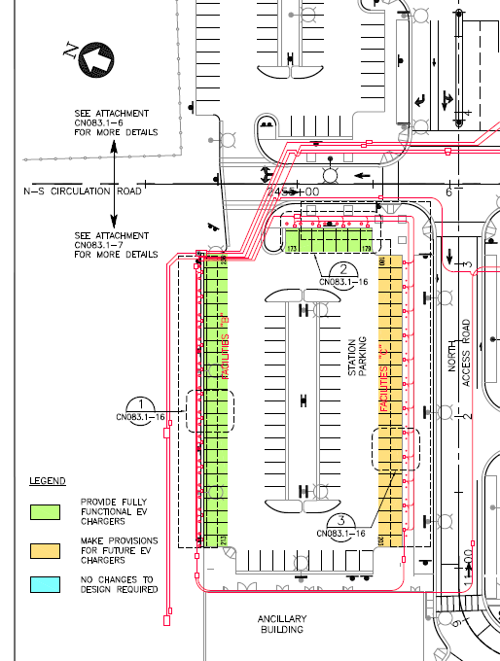
Site Plan- Commercial Installation
Spaces for existing and future charging identified
CALGreen requirements for new construction to be “EV Capable”
  Raceway
  Panel capacity for 40A 208/240V
  Identifying future spaces
Notes:
Example site plan for large commercial installation
Greater number of stations and power requirements may require more equipment and add complexity.
Reference Section 4 for MUD & Non-Residential Inspection Sheet for California Green Building Standards Code (CALGreen) which include building code provisions for EV charging.
See slides 33& 34 for further detail on CALGreen requirements.

Slide 31
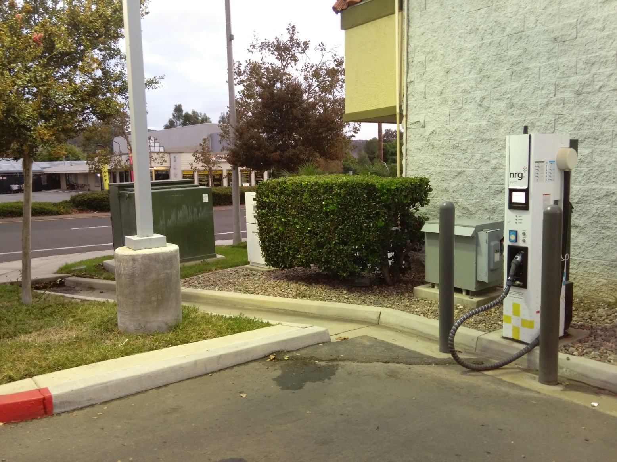
Commercial Installation
Meter Pedestal Panel
Step-up Transformer
SDG&E Transformer
Disconnect w/in line of sight
Physical protection
Notes:
Although this install shows a commercial DC fast charger, it shows components that may be standard on any large non-single family residential, where new or upgraded service may be required.
Reference MUD& Non-Residential Inspection Sheet Section 12a and for disconnects in line of sight.
Reference MUD& Non-Residential Inspection Sheet Section 3, number 3 for SDG&E requirements.
Reference MUD& Non-Residential Inspection Sheet Section 3, number 2 for electrical clearance requirements.
Reference MUD& Non-Residential Inspection Sheet Section 3, number 4 for physical protection requirements such as bollards shown in this slide.

Slide 32
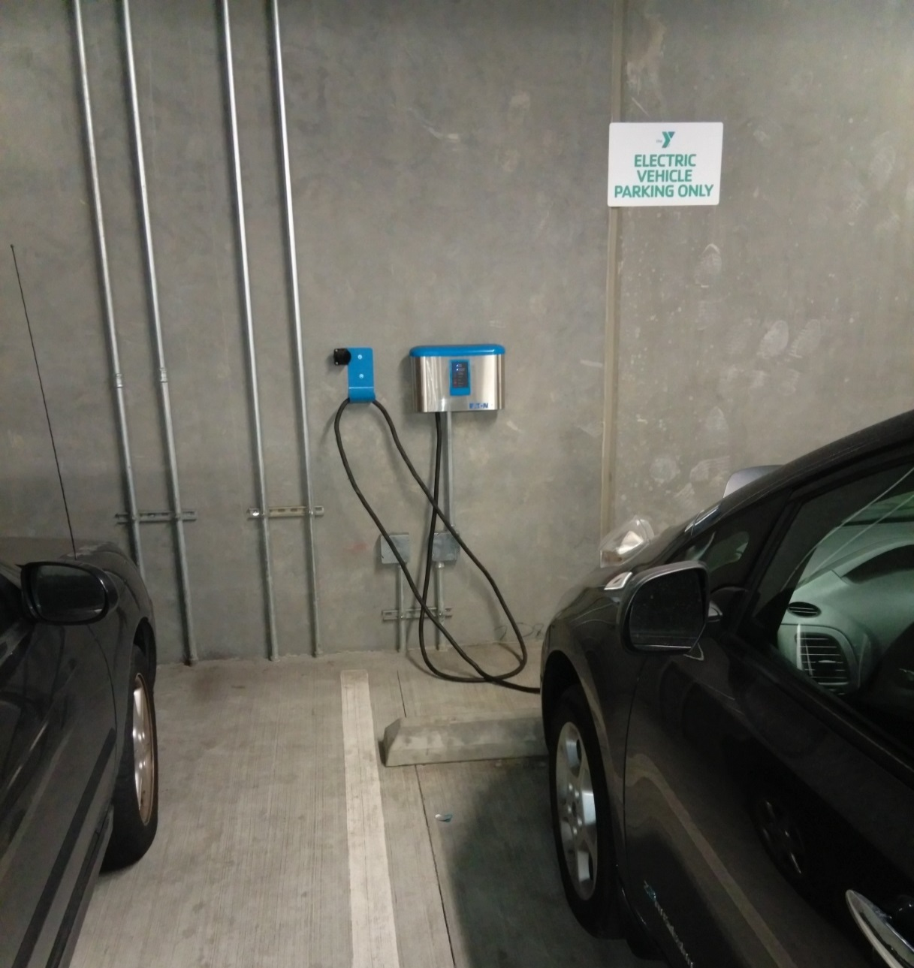
Commercial Installation- Indoor Garage
Vertical clearance
Second junction box for future EV charger
Notes:
Reference MUD & Non-Residential Inspection Sheet Section 3, number 11 for securely fastening wiring and fittings. As inspectors can tell you, different contractors have different notions as what is acceptable in terms of spans, fastening
Reference MUD& Non-Residential Inspection Sheet Section 3, number 5 for vertical clearance at a height of 18-48 inches above the finished floor.
Reference MUD& Non-Residential Inspection Sheet Section 3, number 4 for physical protection requirements such as wheel stops shown in this slide.

Slide 33
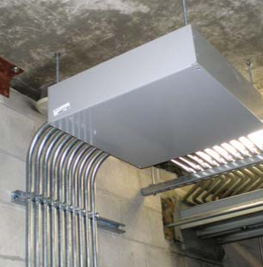
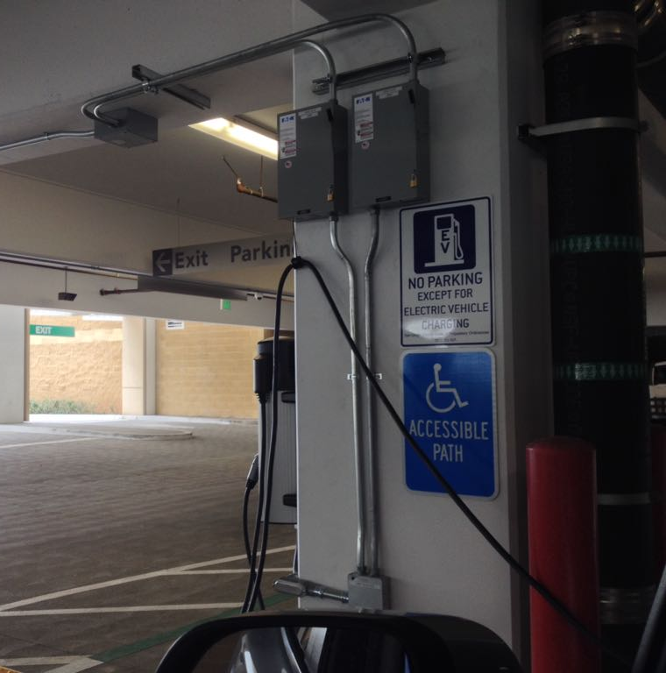
Installing Infrastructure
Notes:
Reference MUD& Non-Residential Inspection Sheet Section 12a and b for disconnects.
Reference MUD & Non-Residential Inspection Sheet Section 3, number 11 for securely fastening pull boxes and fittings.
This also is signed for an accessible path.

Slide 34
EV Infrastructure Requirements

Slide 35
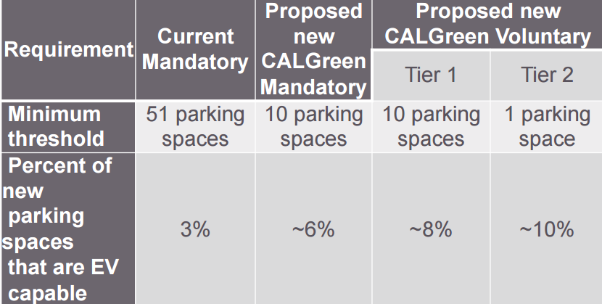
CALGreen Non-Residential Requirements
For non-residential new construction only
Notes:
Proposed CALGreen Codes will go into effect Jan. 2017 if approved by the CBSC. Reference Section 5 for MUD& Non-Residential Inspection Sheet for CALGreen.
For a summary of the mandatory and voluntary code requirements, visit http://www.hcd.ca.gov/codes/calgreen/docs/hcdshl605a.pdf
For new nonresidential construction, the code requires a minimum number of parking spaces to be capable of supporting PEV charging, including installing a listed raceway to accommodate a dedicated branch circuit, providing adequate panel capacity and dedicated conduit for one 208/240 V 40 amp circuit and identifying spaces reserved for future EV charging as “EV Capable.”
Installation of EV infrastructure saves costs for future installs and the code requirements matches the penetration of the market for EVs to sync with the state’s goals for electric vehicles on the roads.

Slide 36
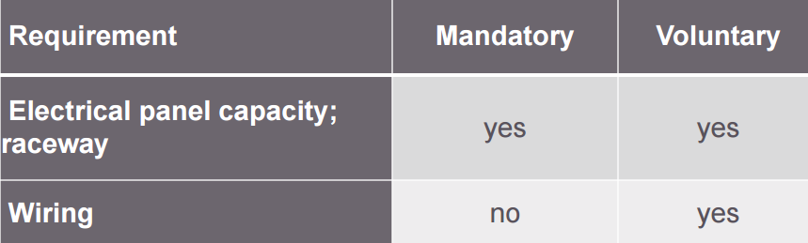
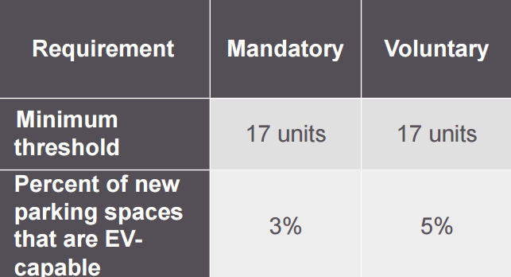
CALGreen Residential Requirements
Single family New Construction
Multi-family New Construction
Notes:
Proposed CALGreen Codes will go into effect Jan. 2017 if approved by the CBSC. Reference Section 5 for MUD& Non-Residential Inspection Sheet for CALGreen.
For a summary of the mandatory and voluntary code requirements, visit http://www.hcd.ca.gov/codes/calgreen/docs/hcdshl605a.pdf
For new residential construction, the mandatory requirements include installing raceway, providing adequate panel capacity and identifying the service panel and termination point as “EV Capable.”

Slide 37
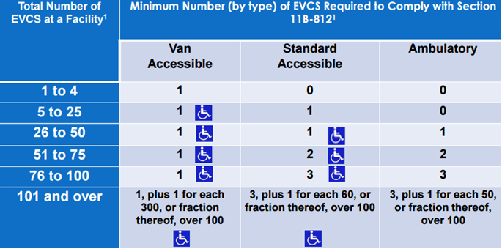
EVCS for Public and Common Use
Table 11B-228.3.2.1
The number of charging ports that can simultaneously charge vehicles is considered the number of EVCS at a facility for regulatory purposes
Notes:
Accessibility requirements define a minimum number of accessible EVCS per the total number of EVCS at a facility based on type of EVCS. There are four types of EVCS accessible spaces as defined. Where four or fewer total EVCS are provided, identification with an International Symbol of Accessibility (ISA) shall not be required.
For more than four total EVCS provided, the van accessible space will be identified with an ISA and is reserved for the use of persons with disabilities. Newly constructed parking facilities, and existing parking facilities that undergo alteration, must meet requirements for accessibility unless otherwise exempted.
The number of EVCS spaces is determined by the number of vehicles that can be charged, not by the number of service pedestals that are installed.
Vehicle spaces serving van accessible EVCS shall be 144 inches (3658 mm) wide minimum and shall have an adjacent access aisle
Vehicle spaces serving standard accessible EVCS shall be 108 inches (2743 mm) wide minimum and shall have an adjacent access aisle
Vehicle spaces serving ambulatory EVCS shall be 120 inches (3048 mm) wide minimum and shall not be required to have an adjacent access aisle.

Slide 38
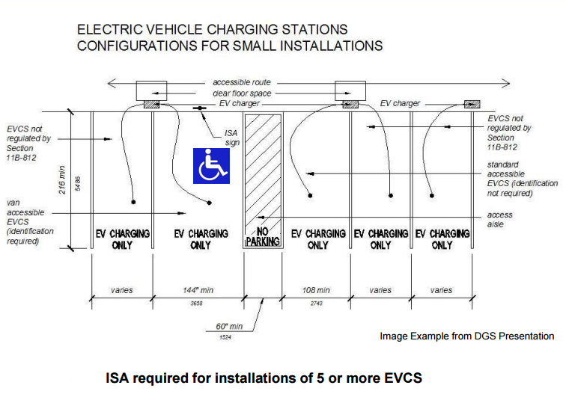
Accessibility for EV Charging
Notes:
An example layout configuration for accessible EVCS installations and dimensions.
http://green-technology.org/gcsummit16/images/3-Building-EV-Charging.pdf

Slide 39
Best Practices
EVCS guidelines and checklists
Clear and consistent website info
Standardization of EVCS building codes and installation requirements
Adoption of voluntary CALGreen codes
Online permitting and inspection services
Permit application for EVCS
  Specific, fillable application
Incentives for permit fees and installations
  EVCS financing programs
Training for electrical contractors
Notes:
Cities can include info on financing programs about EVCS on their websites as well.

Slide 40

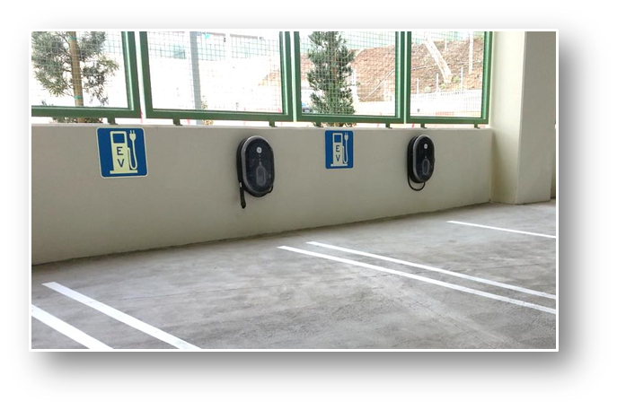
Technical Assistance: EV Expert
Technical infrastructure questions
Call/email or set up an
in-person meeting
EV Expert FAQ
www.energycenter.org/pluginsd
Email EVexpert@energycenter.org
Phone (866) 967-5816
Notes:
EV Expert consultations can help answer technical questions as well as provide broader assistance on complex installs, fleet considerations, etc. The EV expert FAQ on www.energycenter.org/pluginsd provides answers to general questions and more information on equipment, installations, regional planning and location of charging infrastructure in San Diego. The EV expert can share what cities are doing to other cities in the region.

Slide 41

Thank You
Thank you to the San Diego Regional Clean Cities Coalition for providing breakfast

Slide 42
Questions and Discussion
Allison Wood, Allison.Wood@sandag.org
Kevin Wood, kevin.wood@energycenter.org
Candace Chu, candace.chu@energycenter.org
Andy Hoskinson, andy.hoskinson@energycenter.org

Slide 43
Electric Vehicles 101

Slide 44
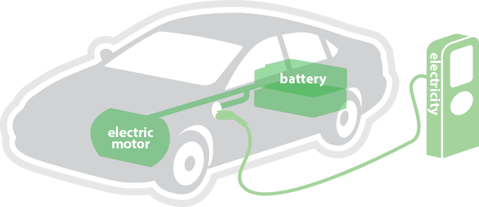
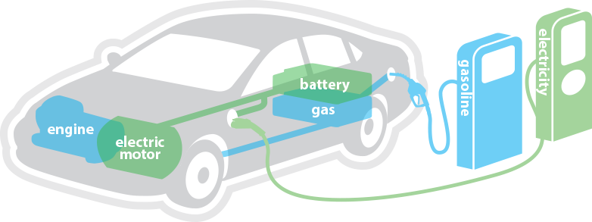
Plug-in Electric Vehicles (PEVs)
Battery Electric Vehicles
  All electric, zero-emissions
  16 models available*
  Examples: Nissan Leaf,
  Tesla Model S, BMW i3
Plug-in Hybrid Electric Vehicles
  Electric battery and gasoline
  10 models available*
  Examples: Chevrolet Volt,
  Toyota Plug-in Prius
*Eligible for the California Clean Vehicle Rebate Program (CVRP)

Slide 45
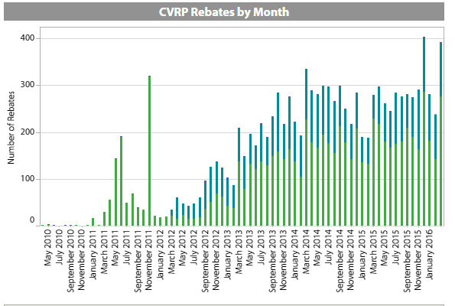

CVRP Rebates in the San Diego Region
Source: Clean Vehicle Rebate Project Statistics as of April 2016
Notes:
Growth in the San Diego region from Rebates Issued
Source: Clean Vehicle Rebate Project (CVRP) Rebate Statistics https://cleanvehiclerebate.org/eng/rebate-statistics

Slide 46
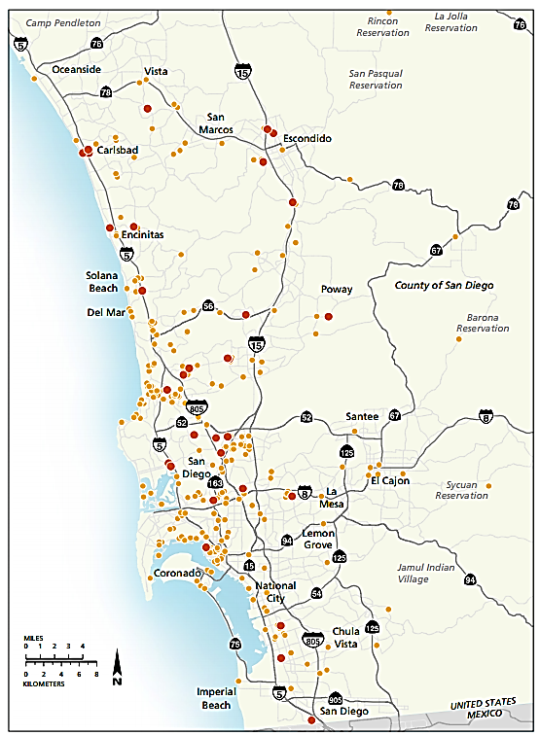

EVCS in San Diego
377 charging locations in the SD region (with a total of about 1,000 plug-in points)
19,000 plug-in vehicles in the region
Source: SANDAG InfoBits (2016)
Notes:
Source: http://www.sandag.org/uploads/publicationid/publicationid_2027_20605.pdf

Slide 47
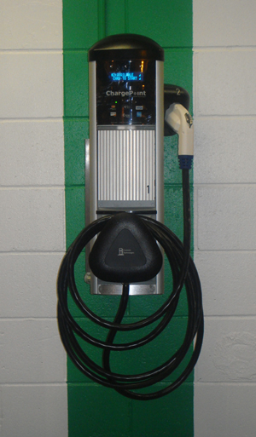
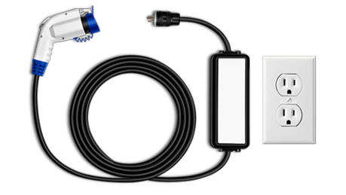
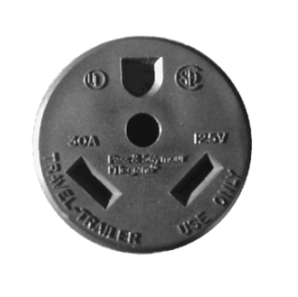
Charging: Level 1 vs. Level 2
AC Level 1
AC Level 2
Uses a standard 110/120-volt alternating current (VAC) three-pronged wall plug
Uses 208/240 VAC and can be hardwired or connected with a plug
Notes:
Reference: Plugshare.com

Slide 48
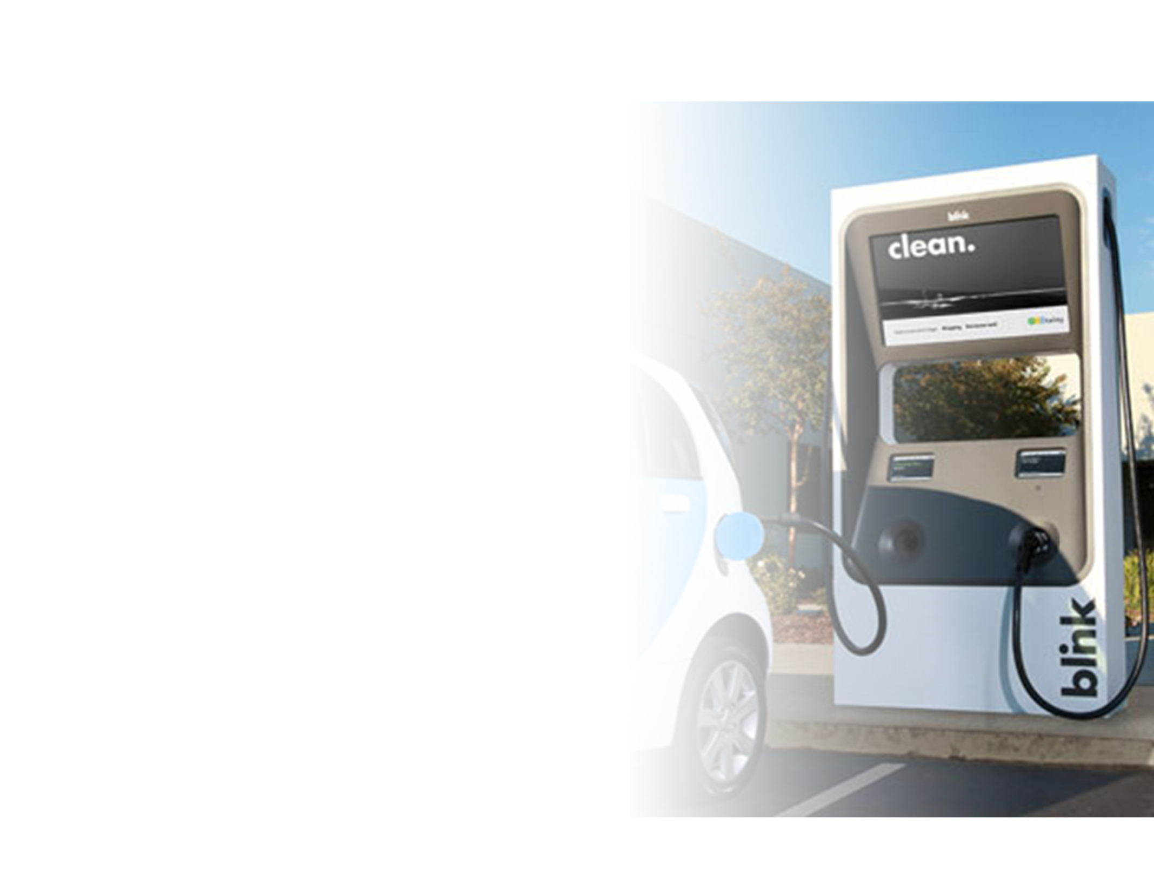
Charging: DC Fast Charging
Uses commercial-grade 440 /480 VAC – produces direct current (DC) to charge
Commercial/Public – due to costs
Provides fast charge for some BEVs

